Slide 1
Wind Turbine Wake Modeling at the National Renewable Energy Laboratory
Nicholas Hamilton
10 February 2021
The Alliance for Sustainable Energy, LLC (Alliance) is the manager and operator of the National Renewable Energy Laboratory (NREL). NREL is a national laboratory of the U.S. Department of Energy, Office of Energy Efficiency and Renewable Energy. This work was authored by the Alliance and supported by the U.S. Department of Energy under Contract No. DE-AC36-08GO28308. Funding was provided by the U.S. Department of Energy Office of Energy Efficiency and Renewable Energy, Wind Energy Technologies Office. The views expressed in the article do not necessarily represent the views of the U.S. Department of Energy or the U.S. government. The U.S. government retains, and the publisher, by accepting the article for publication, acknowledges that the U.S. government retains a nonexclusive, paid-up, irrevocable, worldwide license to publish or reproduce the published form of this work, or allow others to do so, for U.S. government purposes.

Slide 2
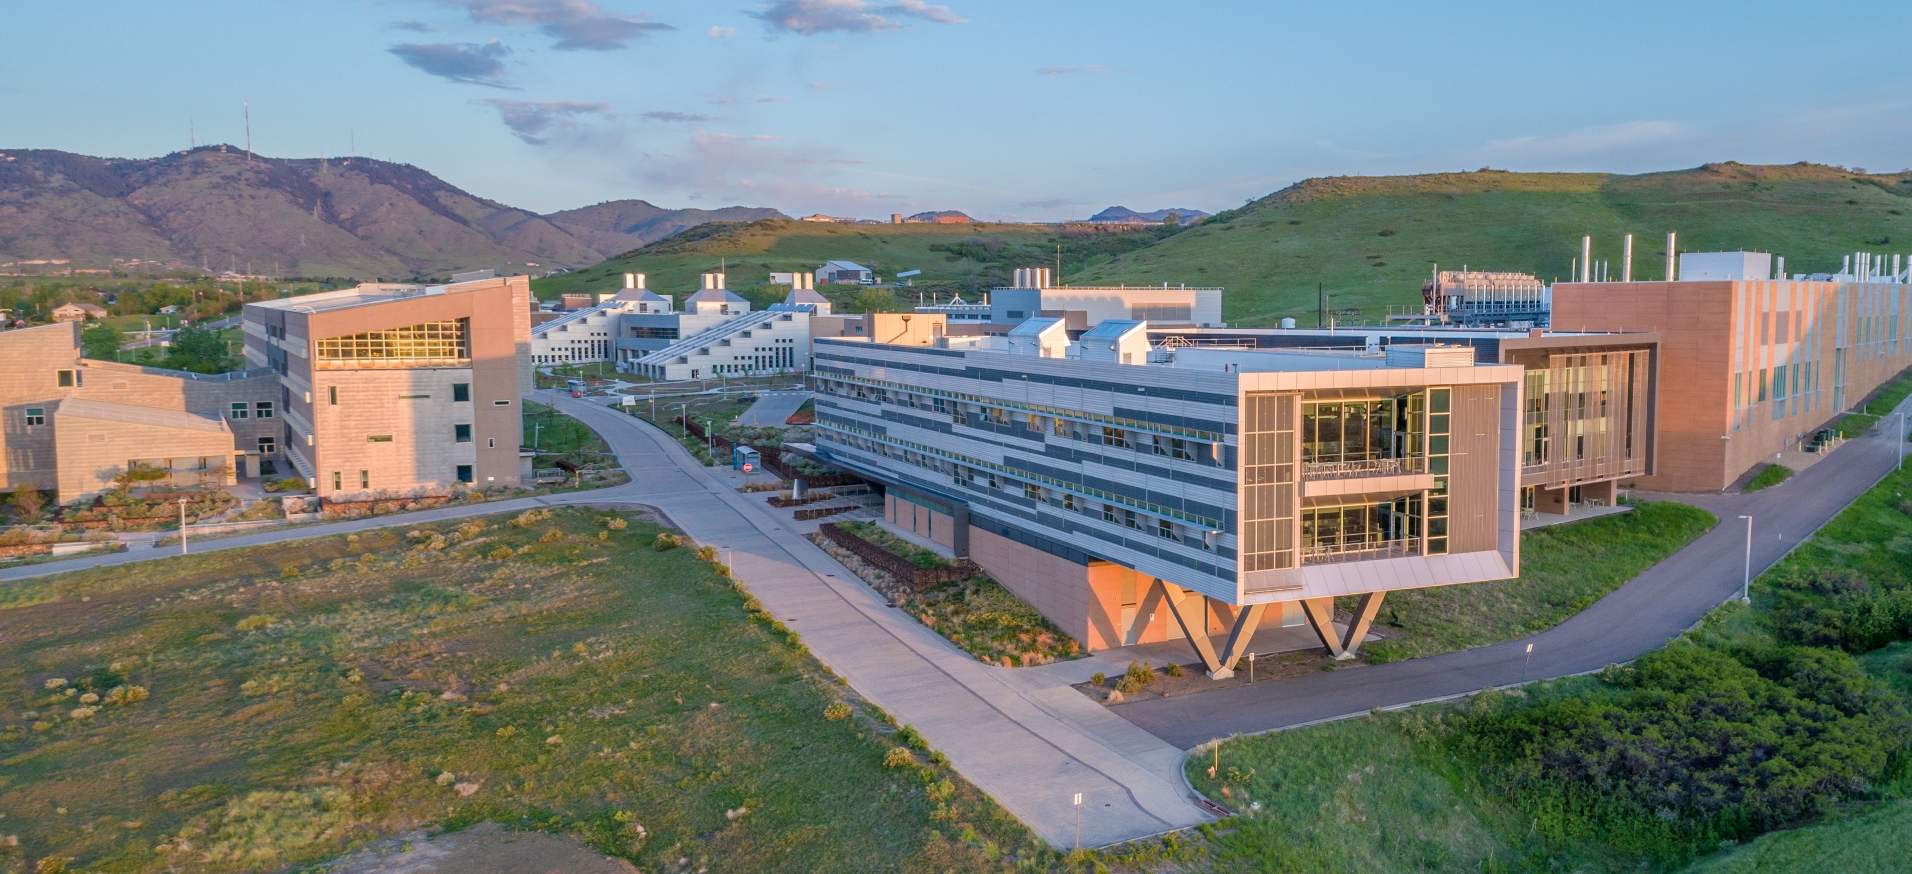


NREL at-a-Glance
2,926
More than
900
Workforce, including
219 postdoctoral researchers
60 graduate students
81 undergraduate students
World-class
facilities, renowned technology experts
Partnerships
with industry, academia, and government
Campus
operates as a living laboratory
Notes:
Picture: 61720. jpg, 6/1/2019, South Table Mountain Campus, (Photo by Joshua Bauer / NREL)
The laboratory’s research and development focuses on secure domestic energy with economic viability.
Today, NREL’s groundbreaking advanced energy research and development spans from foundational science, to research and development, to discovery and invention of methods, to components and energy delivery systems. NREL’s energy analysis informs R&D.

Slide 3
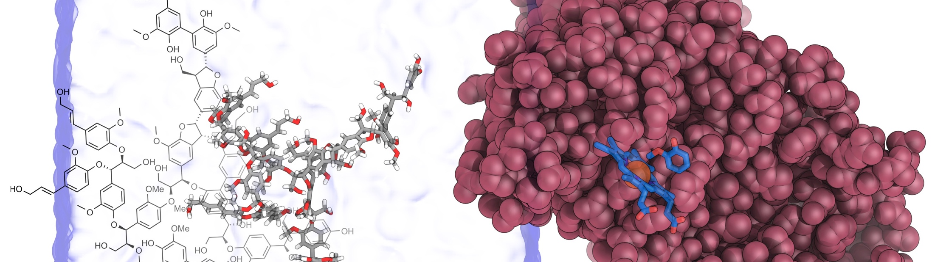

NREL Science Drives Innovation
\
\
\
\
Renewable Power
Solar
Wind
Water
Geothermal
Sustainable Transportation
Bioenergy
Vehicle Technologies
Hydrogen
Energy Efficiency
Buildings
Advanced Manufacturing
Government Energy Management
Energy Systems Integration
Grid Integration
Hybrid Systems
Security and Resilience
Notes:
59664.jpg 10/2/2019 Picture: Enabling microbial syringol conversion through structure-guided protein engineeringByline: Josh Vermass / Brandon Knott, Illustration for Joule publication, "Enabling microbial syringol conversion through structure-guided protein engineering,"
NREL science drives innovation.
Our research in these four main energy sectors boosts economic growth and helps drive the bigger engine of U. S. innovation:
Renewable Power includes solar, wind, water, and geothermal energy technologies.
Sustainable Transportation includes bioenergy, vehicle, and hydrogen technologies.
Energy Efficiency includes building technologies, advanced manufacturing research, and energy management programs.
Energy Systems Integration applies hardware-in-the-loop simulation and emulation, high-performance computing and data/visualization capabilities to assess grid modernization strategies and ways to minimize disruptions to grid services from natural disasters or human attacks.
Headline: PET eating microbe Text: Caption: April , 2019 - NREL researcher Rita Clare works with engineered enzyme Pseudomonas Putida KT2440 in her lab at the FTLB at NREL. (Photo by Dennis Schroeder / NREL)

Slide 4




NREL Core Capabilities: Foundation for Innovation
System Integration
Innovation and Application
Foundational Knowledge
Systems Engineering and Integration
Large-Scale User Facilities
Biological and Bioprocess Engineering
Chemical Engineering
Mechanical Design and Engineering
Power Systems and Electrical Engineering
Applied Materials Science and Engineering
Biological Systems Science
Chemical and Molecular Science
Advanced Computer Science, Visualization, and Data
Decision Science and Analysis
Crosscutting
Notes:
NREL’s core capabilities bring deep understanding of markets and policy, as well as existing and emerging advanced energy and energy efficiency technologies. They also create an understanding of energy systems that support the laboratory’s mission.
Together, these capabilities provide the technical foundation to comprehensively understand national energy challenges and opportunities.
They also guide the focus of the laboratory’s underlying science toward gaining knowledge, supporting technology innovations, and developing integrated systems that will address these challenges.
NREL’s 11 core capabilities derive their uniqueness from this market-facing system solution perspective and experience in clean energy.

Slide 5
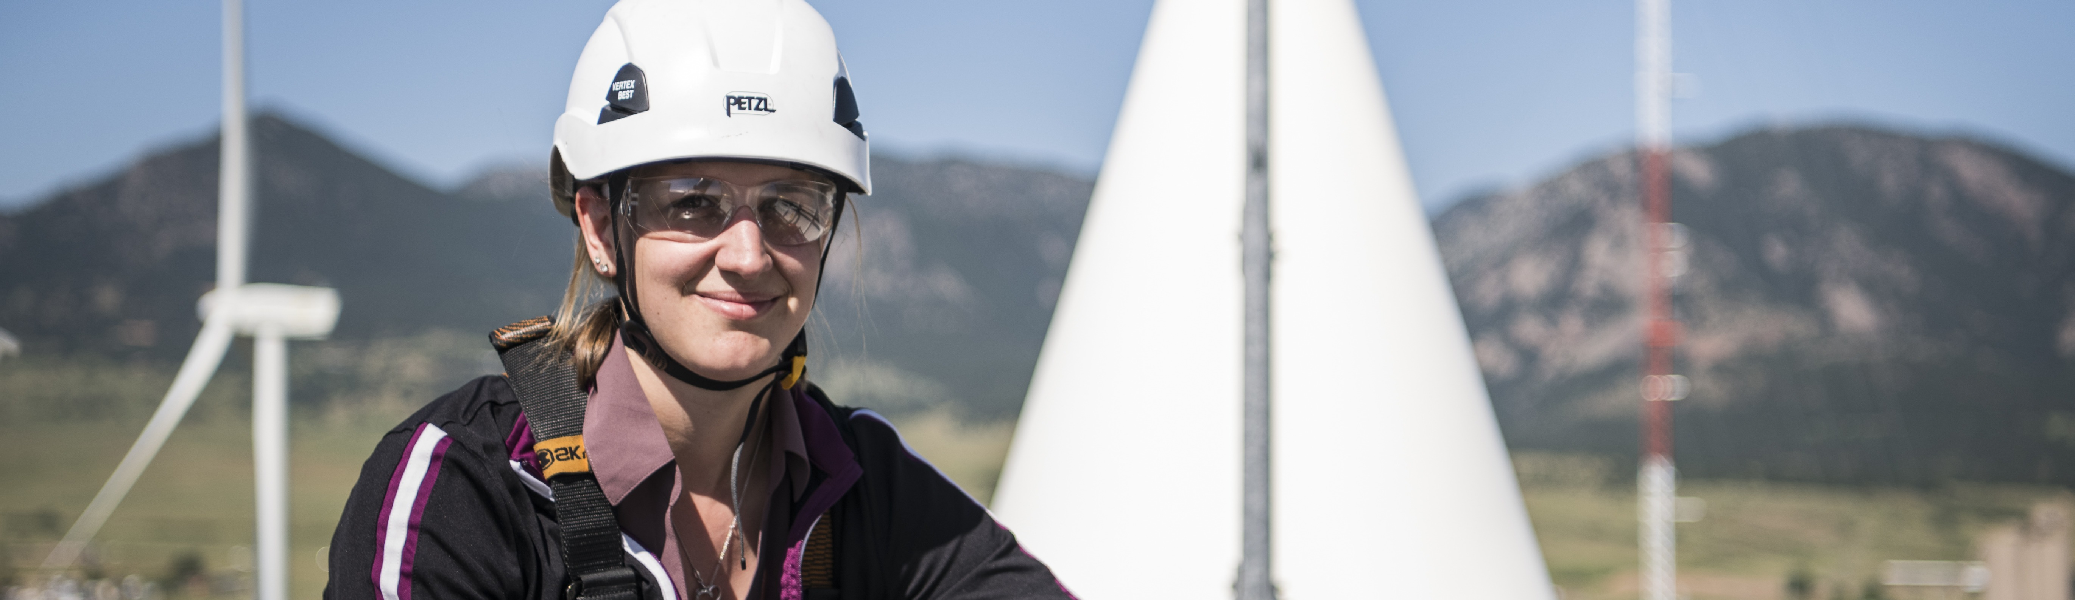
Wind Energy
Enabling low-cost and grid-supporting wind energy by joining forces with DOE, industry, and interagency and state partners to advance scientific knowledge and technological innovation.
Research Challenge
Validate multiple wind technologies at scale to achieve an integrated energy system that can meet the complex energy challenges of the future.
Develop taller wind turbines with larger rotors to capture greater wind resources at higher elevations and lower the levelized cost of wind energy.
Develop innovations for offshore wind such as floating platforms, scaling solutions for larger offshore designs, advanced turbine controls, and lightweight drivetrains.
Optimize total power output across the entirety of a wind plant instead of at the individual-turbine level.
Enable sustainable manufacturing through new materials and new manufacturing processes.
Notes:
Picture: 58259.jpg, 7/29/2019, Jennifer King, Autonomous Energy Grid, (Photo by Dennis Schroeder / NREL)
Some of the largest wind turbines in the world (3 MW) capable of powering nearly 3,000 average U.S. homes are located at NREL’s Flatirons Campus.
Utility-scale wind installations stand at more than 82 GW, enough to meet about 5.5 percent of U.S. end-use electricity demand in an average year.
Wind resources increase with altitude. The current generation of wind towers, however, will not be able to reach the height to harvest this resource.
Tall towers above 120 meters can open up to 2,000 GW of land-based wind resources in the southeastern United States. However, the key challenges are the weight of the blades and the logistics of moving large blades over roads, which is already challenging at 80 meters.
NREL’s WISDEM—a set of models for assessing overall wind plant cost of energy—is set to transform the wind industry. It is the only software that can help wind plant operators streamline operations, increase energy capture, and generate additional revenue—and it’s provided for free.
*Wind power additions continued at a robust pace in 2018, with 7,588 MW of new capacity added in the United States and $11 billion invested.
*In 2018, wind was the third largest source U.S. electric-generating capacity additions, behind solar and natural gas.
*A record level of wind power capacity entered transmission interconnection queues in 2018.
*Source 2018 Wind Technologies Market Report , U.S. Department of Energy, https://www.energy.gov/eere/wind/downloads/2018-wind-technologies-market-report
55189 Picture: February 14, 2019 - NREL researcher Julie Lundquist at the National Wind Technology Center (NWTC). (Photo by Dennis Schroeder / NREL)

Slide 6
Cost for Renewables are Falling
Advanced energy technologies are providing real-world solutions by:
Becoming increasingly cost-competitive
Boosting the U.S. energy industry
Providing jobs for American workers
2019 Xcel pricing for projects due to go online in 2023
Source: Lazard’s 2019 Levelized Cost of Energy Analysis
Notes:
Source: Lazard estimates.

Slide 7
U.S. Electric Generation by Energy Source (2010-2020)
Share of Generation
U.S. Energy Supply is Shifting
Forecast
50%
45%
40%
Natural Gas
35%
30%
25%
Coal
20%
Nuclear
15%
Non-Hydro Renewables
Renewable energy—not including hydropower—currently produces 10% of the total U.S. electricity generation. Within the next two years, this is expected to grow to 13%.
10%
Hydropower
5%
0%
Other
2010
2012
2014
2016
2018
2020
Source: United States Energy Information Agency, Today in Energy, 18 January 2019

Slide 8
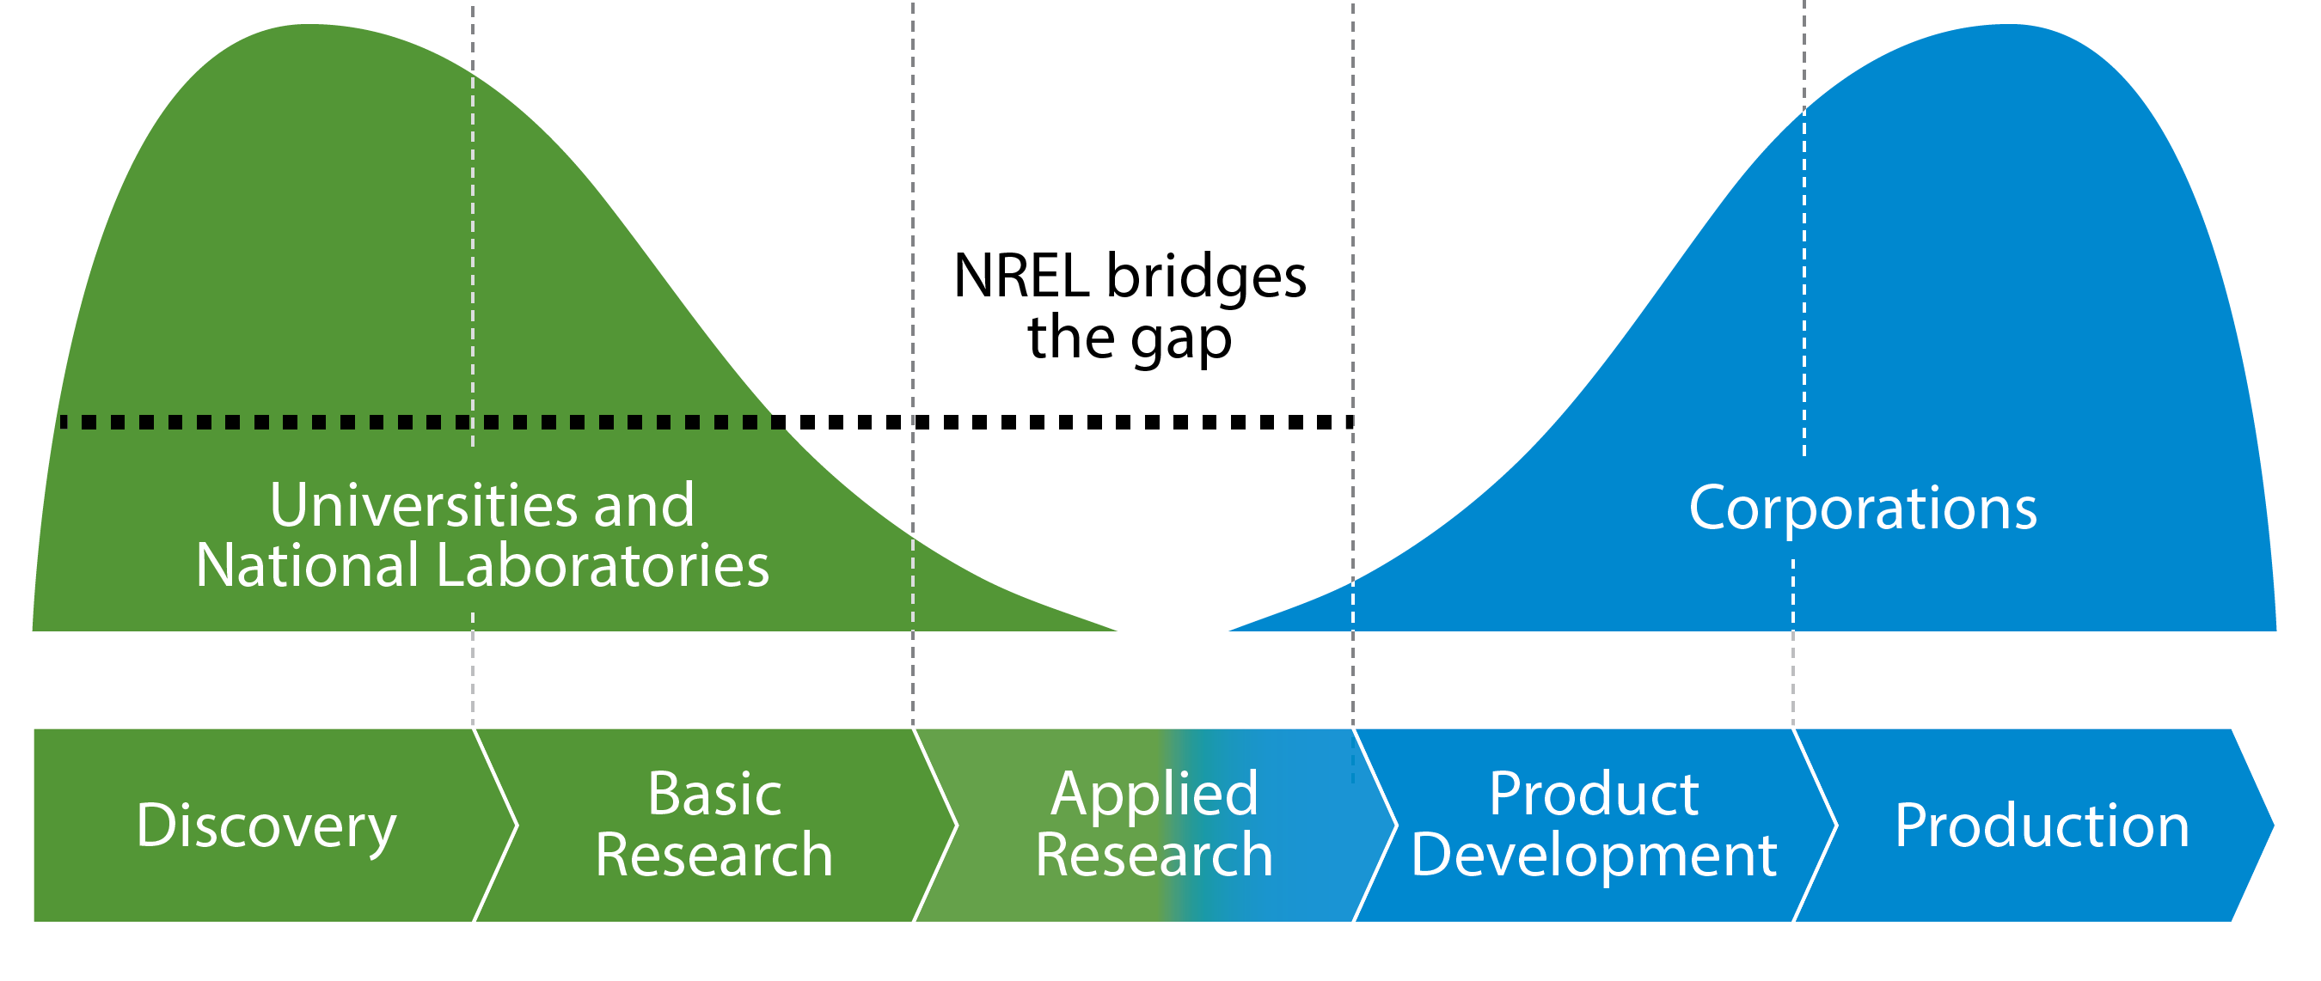
NREL Reduces Risk in Developing New Energy Technology
NREL helps bridge the gap from basic science to commercial application
Forward-thinking innovation yields disruptive and impactful results to benefit the entire U.S. economy
Accelerated time to market delivers advantages to American businesses and consumers
Notes:
Without our expertise, things get a lot riskier for businesses, making it less likely that promising energy technologies make it across that wide gap from concept to market.
NREL is the only national laboratory to fully bridge the gap from foundational science research to examining the feasibility of market applications.
This forward-thinking innovation yields disruptive and impactful results to benefit the entire U.S. economy.
The accelerated R&D timeline made possible through upfront research at NREL delivers net positive returns—both for U.S. businesses and consumers.
Background
For example, it often takes 8 to 10 years or more for new component technology to be fully deployed in commercial vehicles. Any research that NREL can conduct in advance of transferring that technology to industry makes it all the more likely that new, reliable, safe, and affordable transportation options will be available to American consumers sooner.
(statistic from Transportation Energy Futures/Vehicle Technology Deployment Pathways: An Examination of Timing and Investment Constraint)
This approach allows industry to contribute expertise where it is most valuable:
Car companies focus on vehicle engineering, not testing the reliability of a hydrogen fueling station.
Energy companies concentrate on operational decisions, not keeping detailed data on where the sun shines.
Individual companies can be confident that on-site charging stations will be economically beneficial without needing to build a grid-scale testing facility that they only need to use a few times a year.
That’s why companies such as General Motors, Duke Energy, GE, and other industry partners rely on our research expertise – as well as tools, data, and expert analysis – to help steer billions of dollars in manufacturing and workforce development investments.

Slide 9
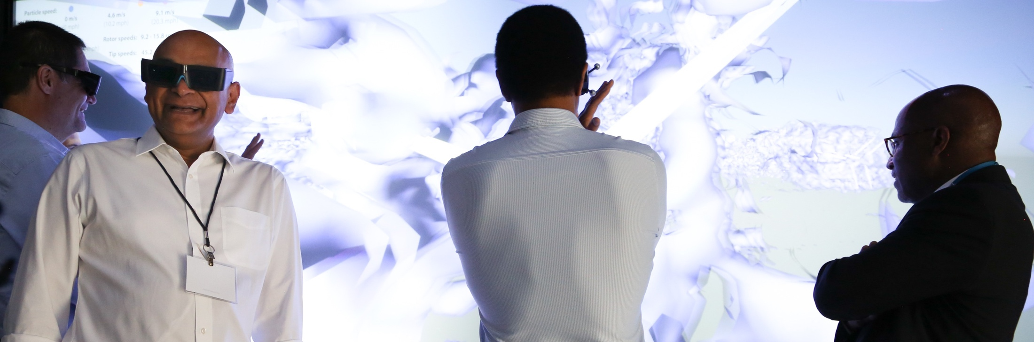
Why Can’t Industry Do What We’re Doing?
Industry invests in short-term R&D when they are confident about a return on investment. NREL:
Assumes a longer, broader view.
Takes on early-stage, high-risk R&D.
Conducts research that makes it possible for industry to bring important new solutions to the market.
“It is often too risky for the private sector to be on that bleeding edge of research where profits are years and years away.”
Venkatesh Narayanamurti, Harvard Kennedy School professor of science and technology policy, told The Washington Post
Notes:
Picture: 58976.jpg, 8/13/2019, Eaton Tour at the Energy Systems Integration Facility, (Photo by Amy Glickson)
NREL scientists and engineers are able to take a longer and broader view focused on the good of the nation as a whole, rather than returns for one individual company.
We take on early-stage, high-risk R&D that leads to dramatic innovation, then make those breakthrough discoveries available to American companies, which gives U.S. industry a leg up.
Our world-class researchers provide the scientific building blocks for new technologies and approaches, answering key questions about technological and commercial viability, making it possible for industry to bring important new solutions to market faster.

Slide 10
NREL Operates in a Space that Coordinates Research and Technology Needs Across Sectors
Academic Institutions
Industry
Government
Agency
Fundamental Science and Engineering
Technology to market
Policy and regulation
High-risk research focus
Advancing TRL of new technologies
NREL is the only National Lab dedicated exclusively to renewable energy science and technology

Slide 11
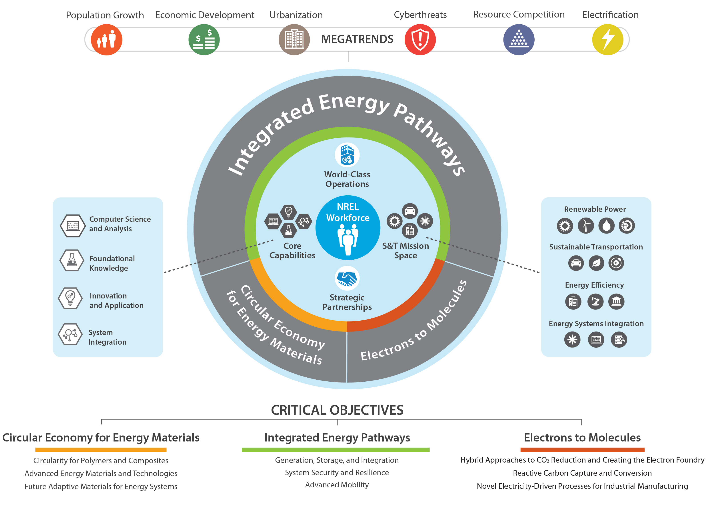
Working Toward Our Vision
Notes:
Talking Points
NREL’s 10-year vision transforms today’s energy challenges into tomorrow’s solutions
The strategy is based on a three-pronged approach:
NREL’s vision lays the foundation for scientific research and technological innovation to shape a highly efficient and resilient energy future.
Key Point: NREL’s long-term vision considers major external megatrends and contemplates possible futures for the world.
Key Point: The laboratory’s vision charts a course for continued leadership in energy innovation and transforming energy systems around the world.
NREL’s long-term vision focuses on three critical research areas that respond to existing energy challenges and will increase our impact.
Key Point: Integrated Energy Pathways is our key strength as it aligns with our core research capabilities and mission; Electrons to Molecules and Circular Economy for Energy Materials are emerging opportunities expected to help address future global energy challenges.
Key Point: Our strategic vision for the next decade builds on our core capabilities and programs to enhance our impact through these three research areas.
Key Point: These three primary areas of opportunity strongly leverage our existing research and development activities but also call on us to expand on and create new capabilities.
NREL’s vision informs the laboratory’s research roadmap and also serves as a guide for others wanting to collaborate and innovate toward similar goals.
Key Point: NREL’s long-term vision is elevated by our work with partners in industry, academia, governmental institutions, and other organizations.
Key Point: The essence of this vision is to chart a course from the current state of our S&T programs and core capabilities to a future state in which we have the programmatic support, partnerships, and capabilities needed to achieve these critical objectives and truly transform global energy systems.
NREL already is making substantial investments in our S&T programs and core capabilities to support these objectives through our annual operating plans (AOPs) and targeted Laboratory Directed Research and Development (LDRD) projects. We also are actively proposing new research projects in existing programs that align with this strategy—providing this prospective thought leadership for DOE is one critical role we play as a national laboratory.
Mission Support
NREL’s mission support functions are foundational to our success in meeting these critical objectives and, more broadly, our current set of S&T priorities. These functions make it possible to:
Recruit and retain the right people with the right knowledge and expertise
Build and maintain critical facilities and systems and keep them secure
Procure and maintain our essential research and operational equipment to ensure safety
Develop an implementation plan and communications strategy to promote our progress
Manage the agreements and finances to ensure efficient business practices
Foster strategic partnerships to elevate our impact
This strategic plan will help us transform our S&T programs and core capabilities to a future state in which we have the programmatic support and capabilities needed to build a robust research portfolio enabling the three critical objectives. This effort will provide a partnership portfolio and impactful research that accelerates transformative innovations and their adoption in the market, which will help us contribute critical innovations to advance scalable solutions in the United States and across the globe. To chart this course effectively, we must acquire the facilities and equipment needed to implement them, expand the reach of our partnerships, and support our people with the work environment they need to be successful.

Slide 12
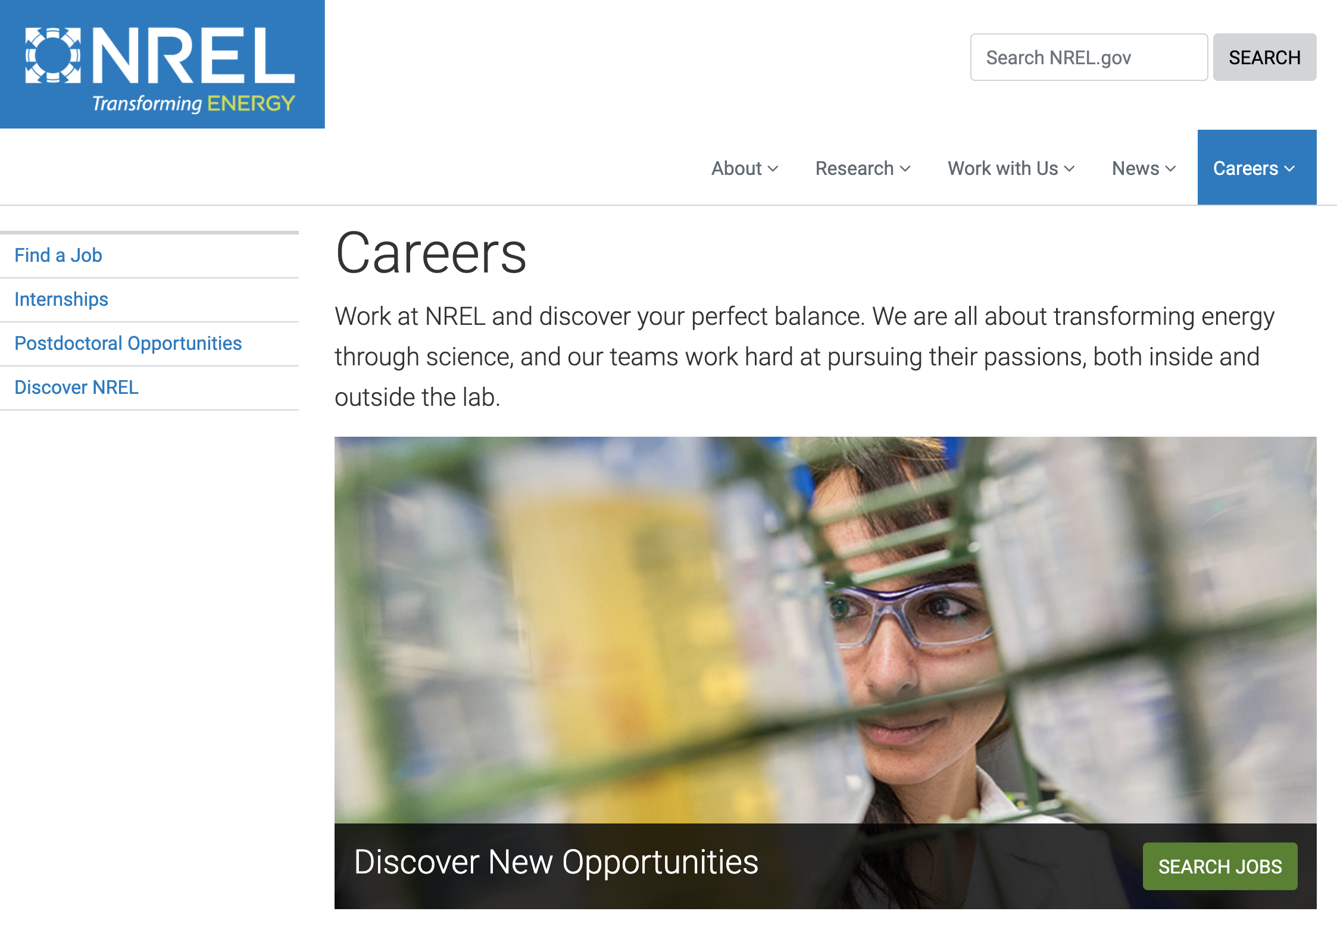
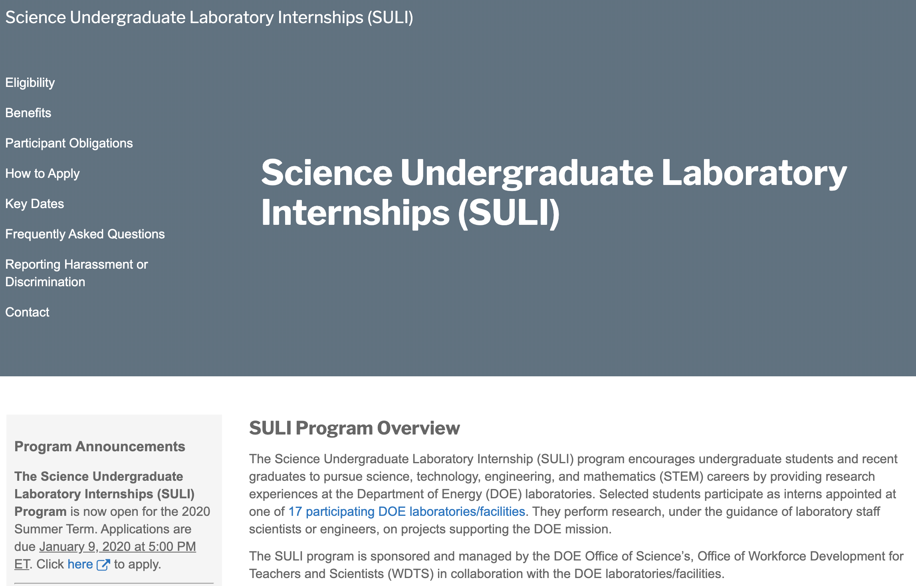
Opportunities at NREL
May 28, 2020 5:00 PM ET
https://www.nrel.gov/careers/
https://www.energy.gov/diversity/events/science-undergraduate-laboratory-internships-suli

Slide 13
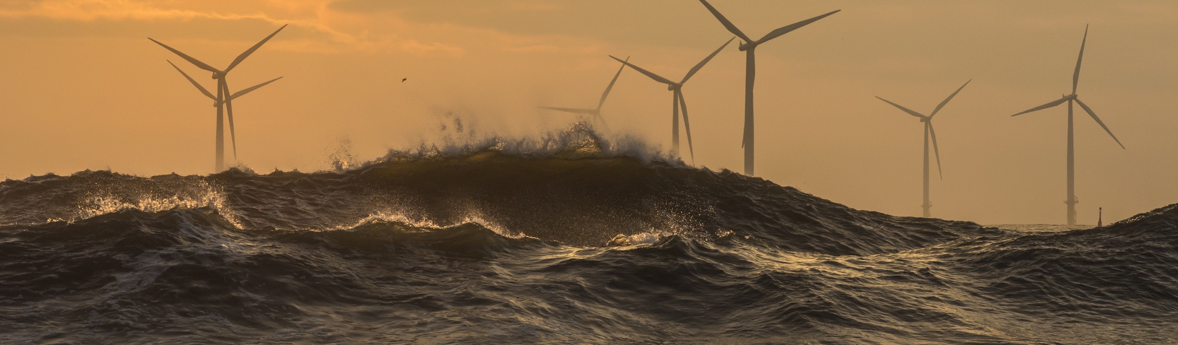
What’s next for wind?
Offshore wind development in US is accelerating
Information in the wind sector is modernizing
Wind is starting to provide additional grid complexity and grid services

Slide 14
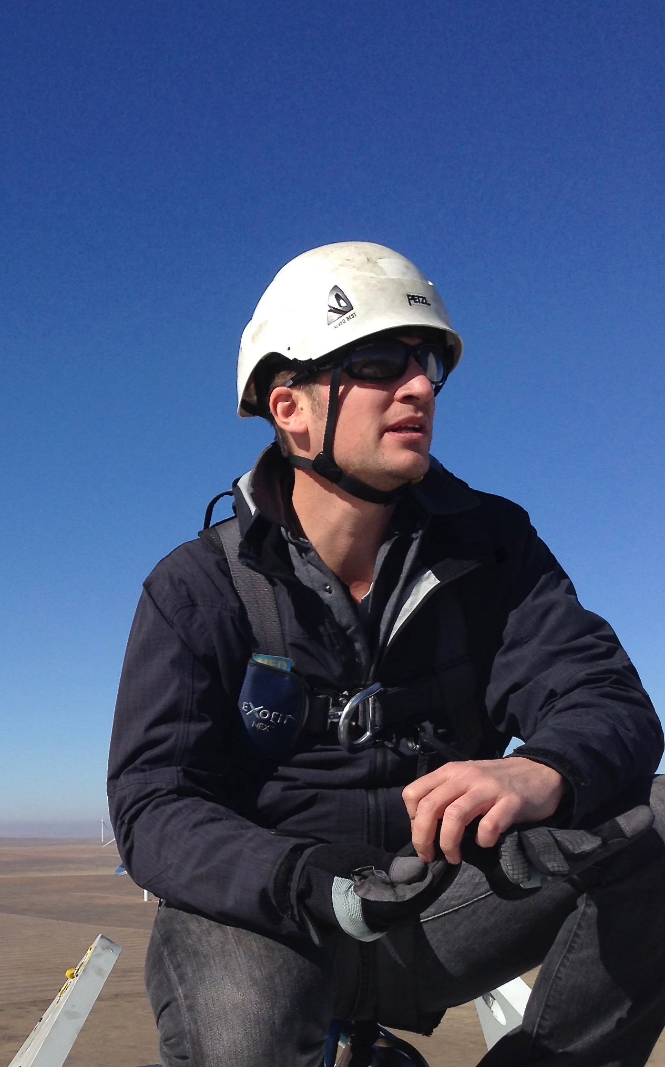
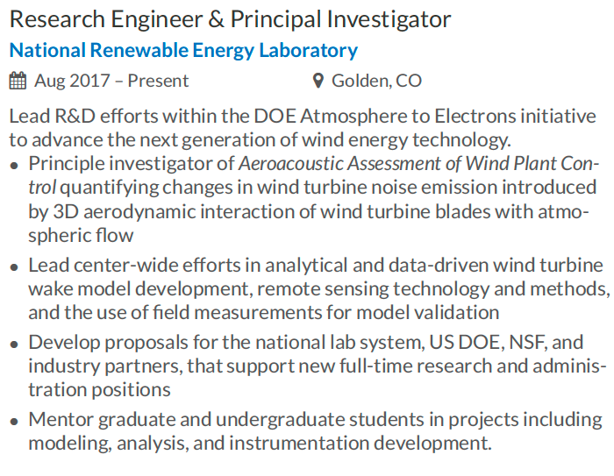
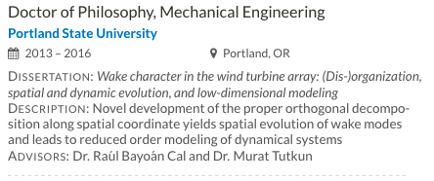
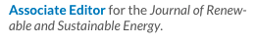
Bio:
Github
Google Scholar
Portfolio
LinkedIn

Slide 15
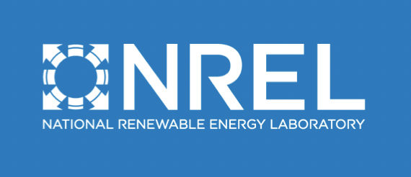
Contact
Nicholas Hamilton
Researcher | National Renewable Energy Laboratory
Nicholas.hamilton@nrel.gov
O: 303.384.6945 who has an office anymore?
M: 720-551-1897
www.nrel.gov

Slide 16
Wind Turbine Wake Modeling

Slide 17
Wind Turbine Wakes
Wind turbines extract kinetic energy from the atmosphere leading to:
Region of reduced momentum
Increased turbulence
Power losses for downstream turbines
Variability in plant behavior
Constraints on wind plant design
Tommy Herges, Sandia National Laboratory https://www.energy.gov/eere/wind/articles/atmospheric-conditions-drive-turbine-wake-behavior-sandia-national-laboratories

Slide 18
Wake Model Fidelity
Engineering Models
Reduced-order Models
Analytical Models
RANS
LES
DNS
Low
Mid
High

Slide 19
Wake Model Fidelity
Computational Fluid Dynamics
Engineering Models
Reduced-order Models
Analytical Models
RANS
LES
DNS
Low
Mid
High

Slide 20
Wake Model Fidelity
Computational Fluid Dynamics
Engineering Models
Reduced-order Models
Analytical Models
RANS
LES
DNS
Low
Mid
High
Stream Tube
Wake is resolved, rather than modeled
Empirical Correlation
Surrogate Modeling
Deep Learning / Data-Driven Modeling

Slide 21
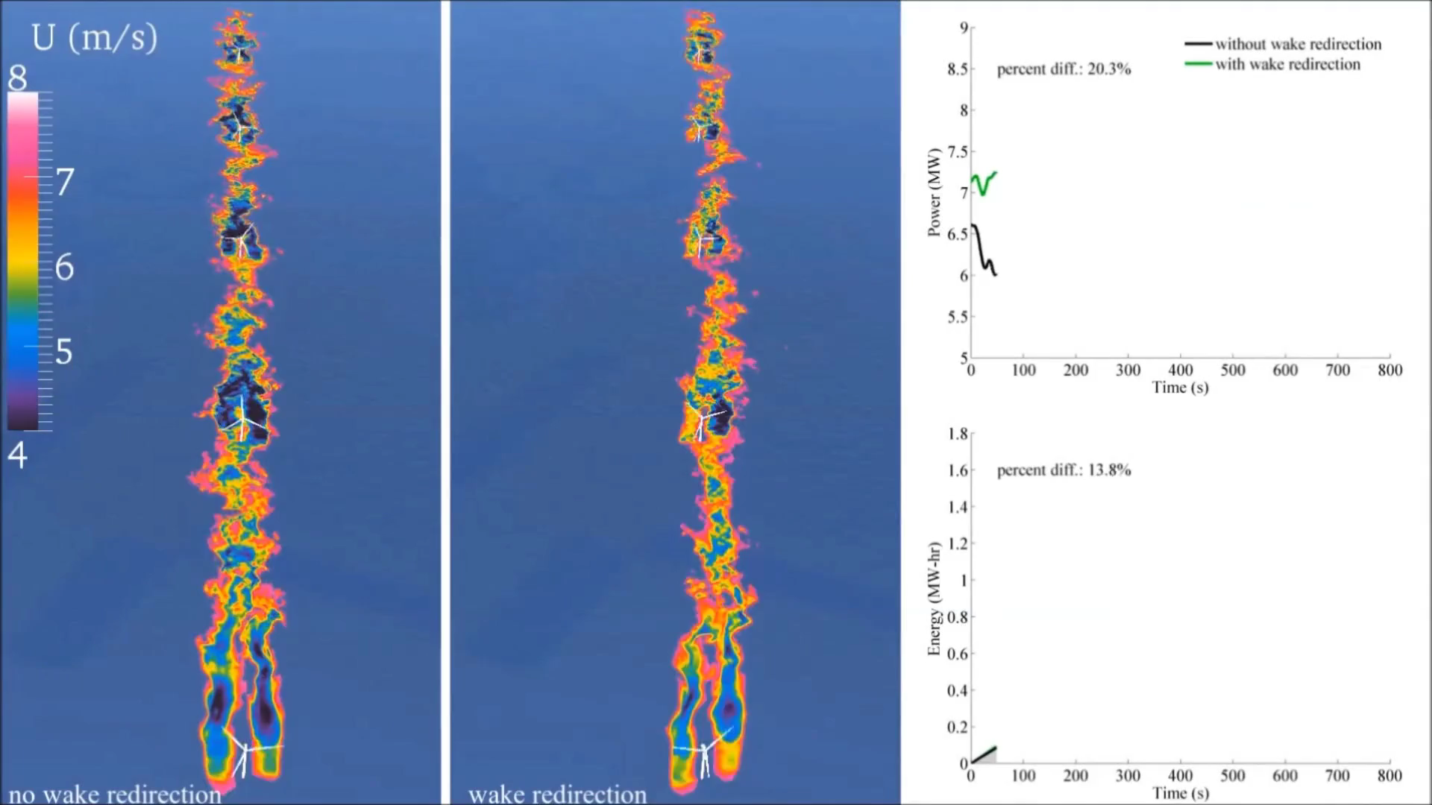
Wake Steering
Notes:
Wake steering has been studied in computer simulation, wind tunnels and more recently in field validation
The controlled studies have typically focused below-rated neutral conditions
How are we doing on rated conditions, and more specifically stable conditions

Slide 22
Wake Model Fidelity
Computational Fluid Dynamics
Engineering Models
Reduced-order Models
Analytical Models
RANS
LES
DNS
Low
Mid
High
Stream Tube
Empirical Correlation
Surrogate Modeling
Deep Learning / Data-Driven Modeling

Slide 23
WRF
Regional
FAST.Farm
FLORIS
WISDEM
Plant
NaluWind
SOWFA
FAST
Turbine
Low
Mid
High
Computational Fluid Dynamics
Engineering Models
Reduced-order Models
Analytical Models
RANS
LES
DNS

Slide 24
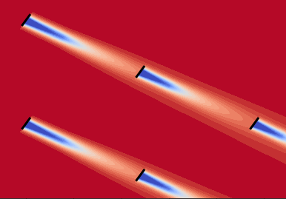
FLORIS
FLORIS is an engineering code for wind farm controls, includes:
Wake models
Design and Analysis tools
Turbine Models
Wake Models
Design Tools
Analysis Tools
https://github.com/NREL/floris

Slide 25
FLORIS
New turbine, turbulence or wake models
FLORIS
Controllers for field trials, AEP analysis
LES, Field Data
https://github.com/NREL/floris

Slide 26
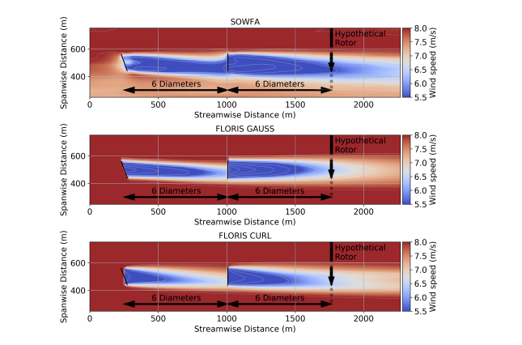
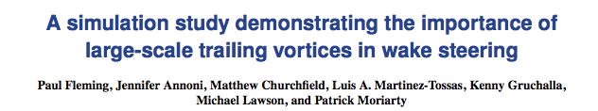
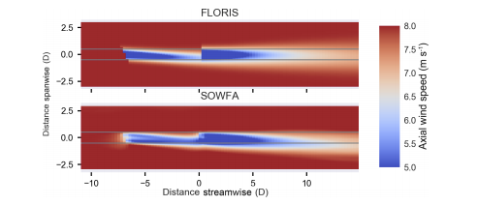
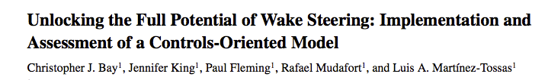
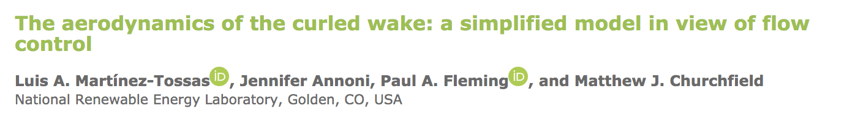
FLORIS
New turbine, turbulence or wake models
FLORIS
LES, Field Data
https://github.com/NREL/floris

Slide 27
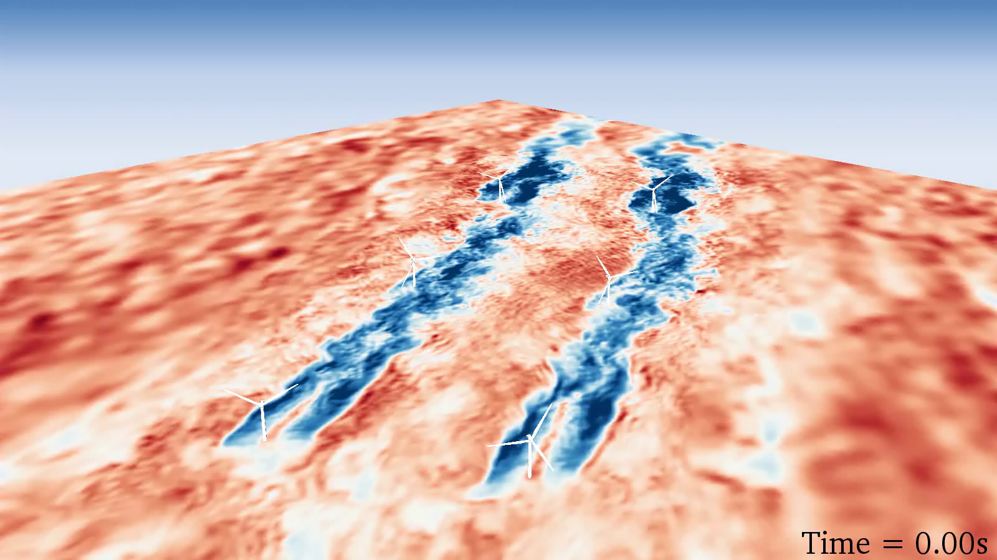
Calibration
FLORIS has been calibrated and evaluated most extensively against the NREL LES tool SOWFA
Historically, these simulations have focused on below-rated conditions
2: Below Rated
2.5: Transition
3: Above Rated
Torque is controlled
To maximize power capture
Transition between region 2 and region 3
Pitch is controlled to maintain rated power

Slide 28
Calibration
Why focus more on rated conditions?
Region 2.5
Region 3
Region 2
Region 1
Region 1.5
Wake losses are most pronounced
Steady control is simple to model
Yaw impact on c_{p}/c_{t} most evident

Slide 29
FLORIS Demo

Slide 30
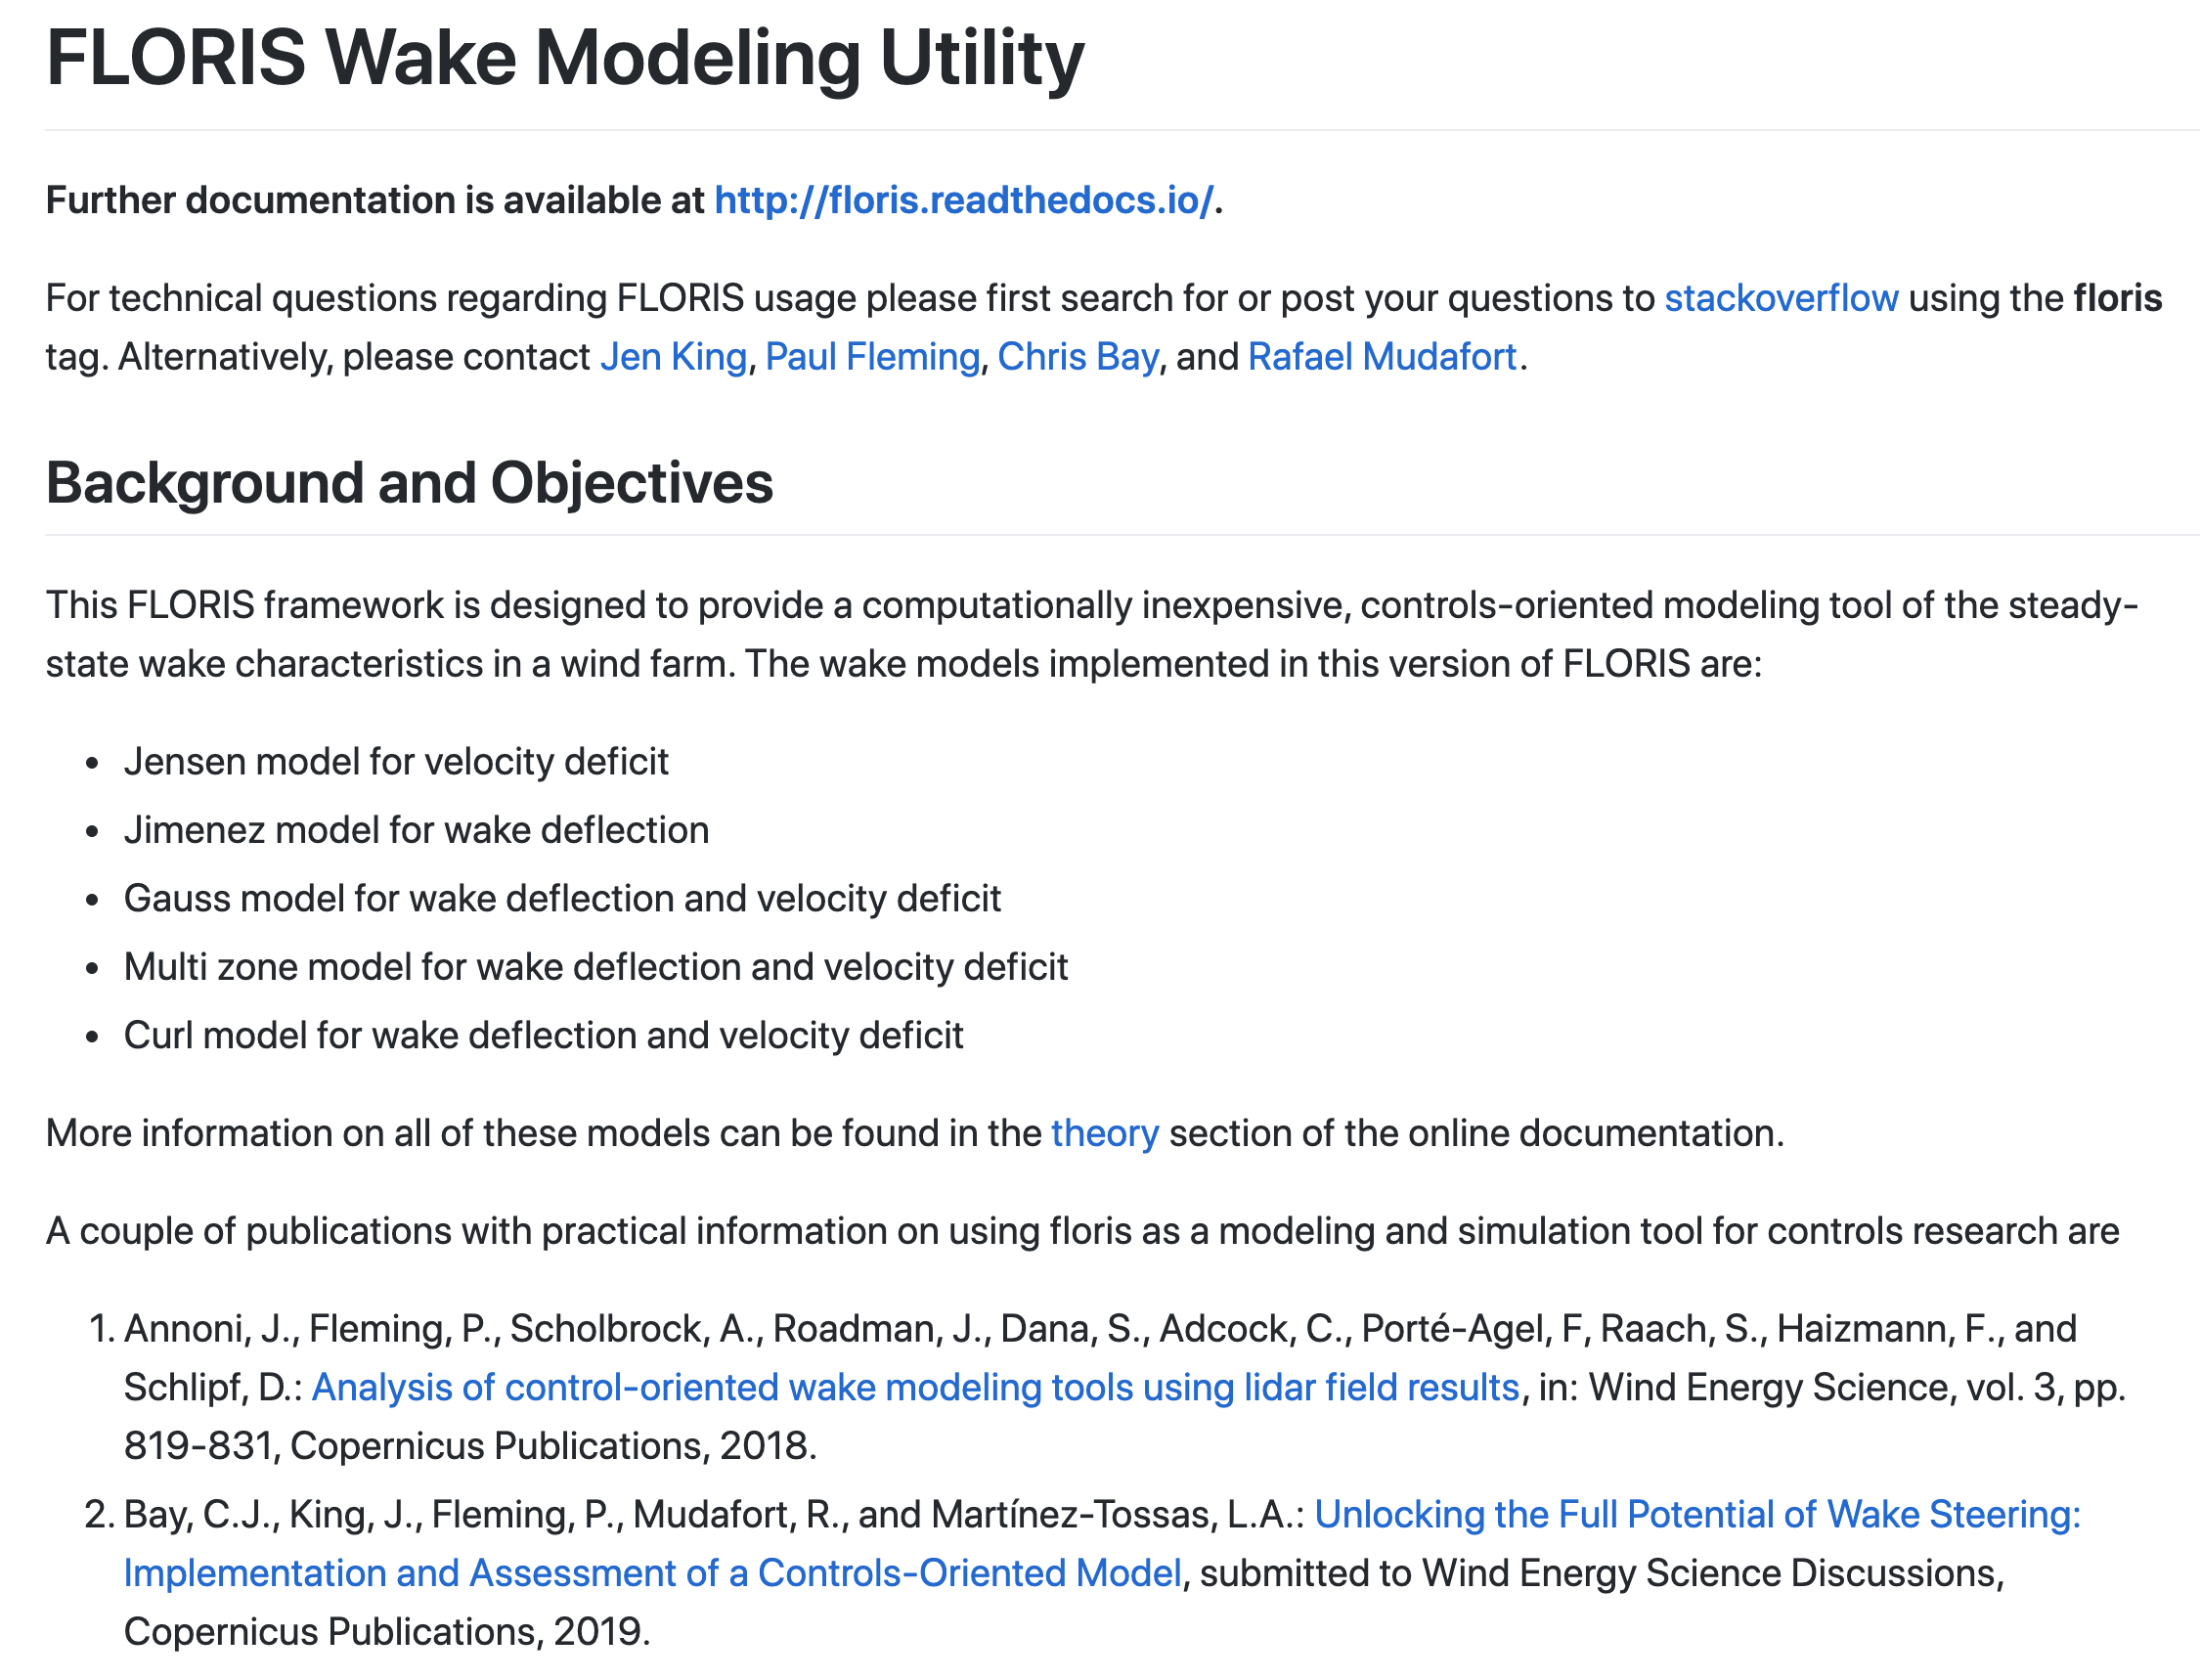
FLORIS Demo
The full code base is available on GitHub
Python 3.7
Open source
Feature development branches
Examples a’plenty
https://github.com/NREL/floris

Slide 31
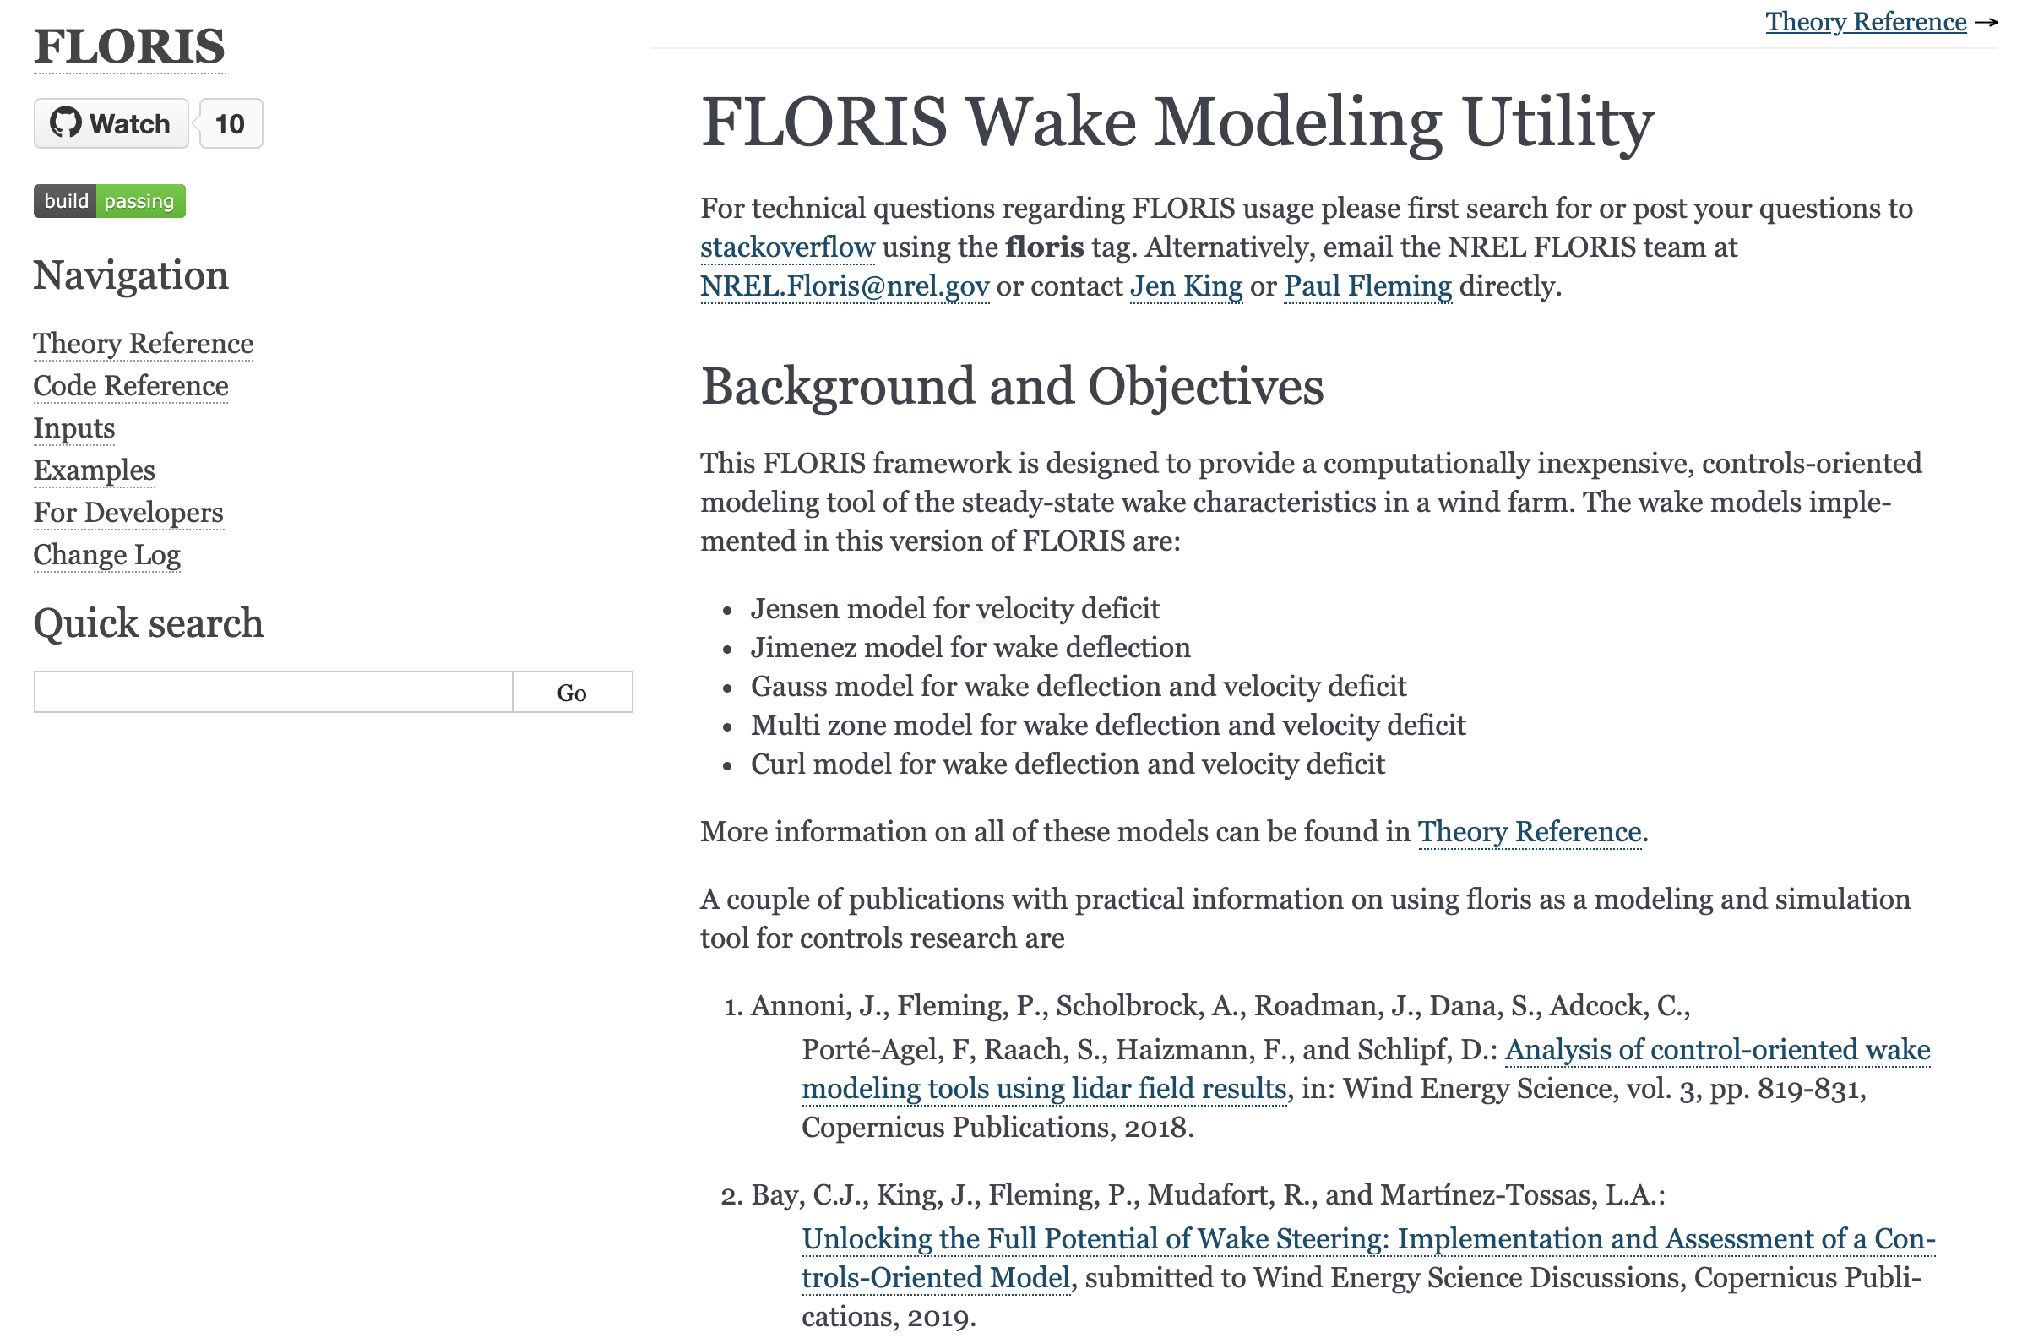
FLORIS Demo

Slide 32
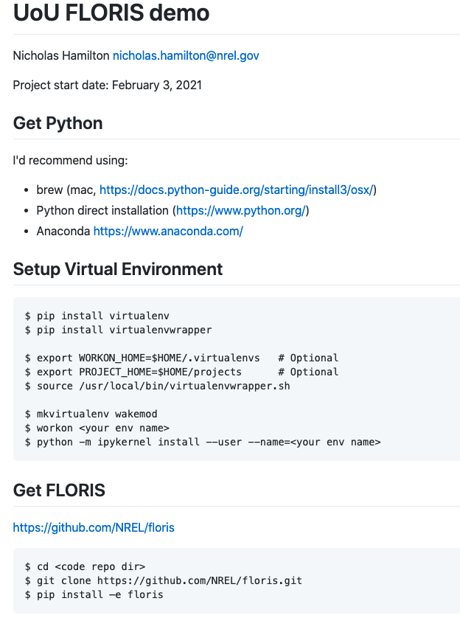
FLORIS - Examples
Start here!
https://github.com/nhamilto/UoU_FLORIS_demo

Slide 33
FLORIS - Ongoing Work

Slide 34
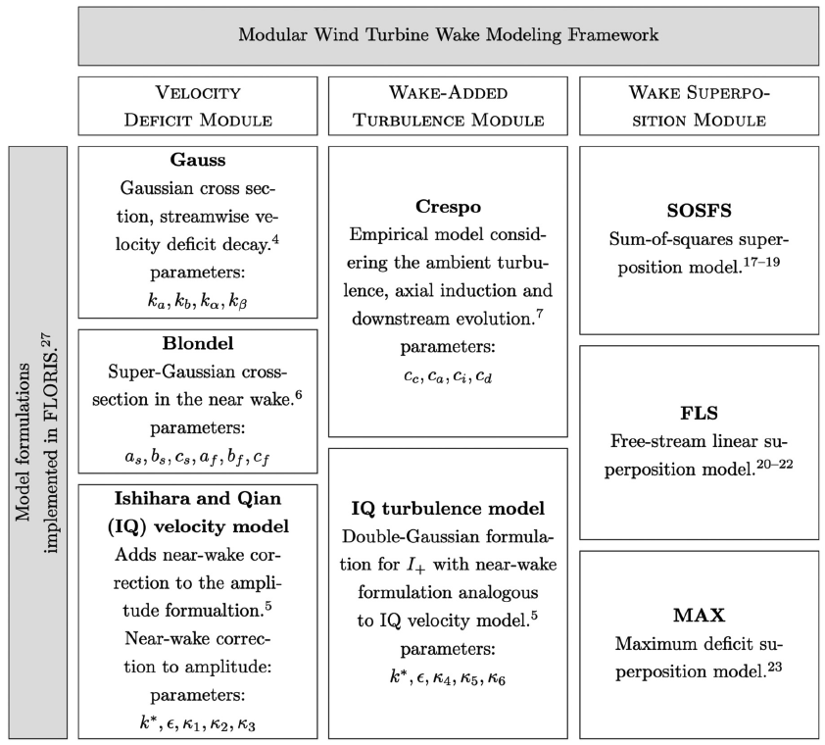
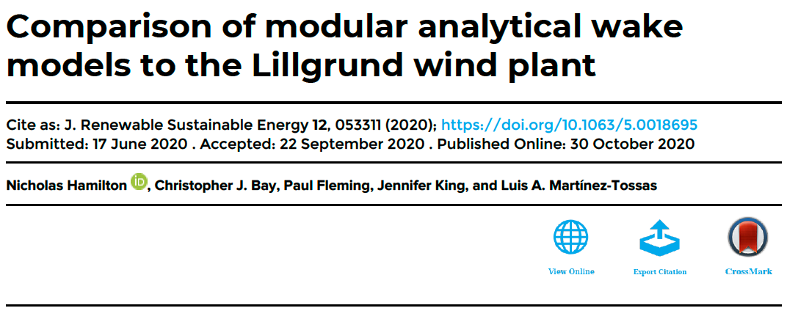
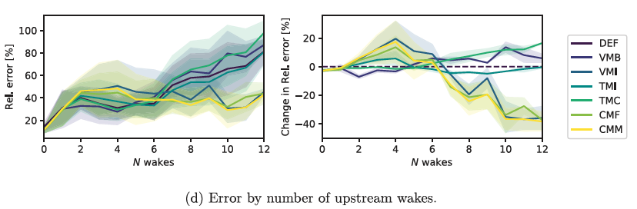
FLORIS - Ongoing Work

Slide 35
Field campaign with NextEra Energy Resources

Slide 36
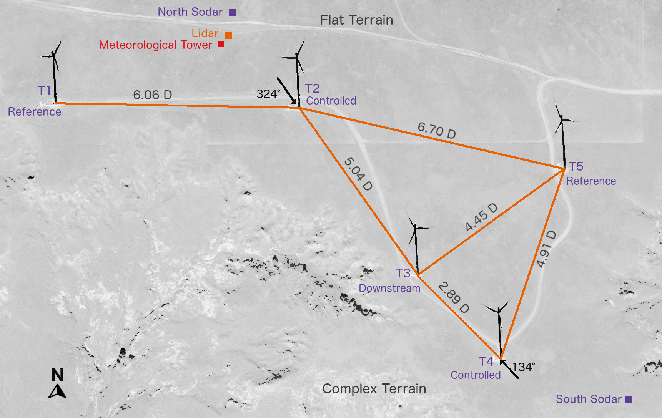
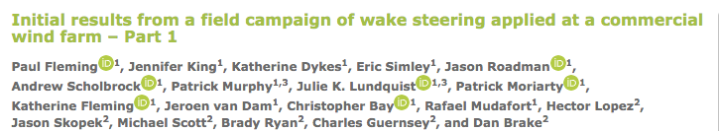
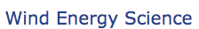
Field Validation Campaign of Wake Steering
Validation campaign collaboration with Nextera Energy Resources
Phase 1 results have been published
This presentation will use initial results from phase 2

Slide 37
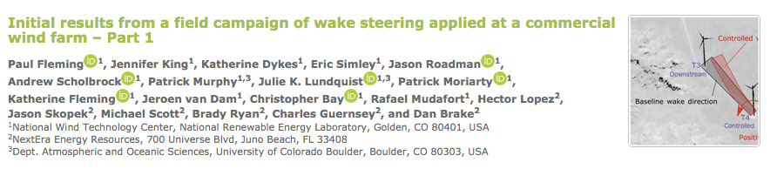
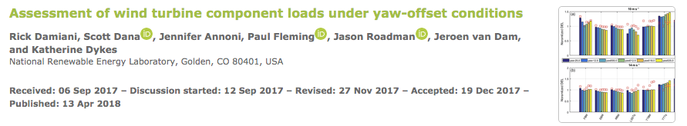
Project Phase 1 and Phase 2
Phase 1
Summer conditions, winds predominantly from the south
Used static optimal settings of yaw offsets
Results published online
Phase 2
Winter conditions, winds predominantly from north
Used offsets designed assuming variation/uncertainty of inputs
Increased use of offsets in higher wind speeds within limits from study by Damaini, et al.

Slide 38
Data Routing
Data
Collection
Baseline
Energy Ratio
FLORIS
Offset
Schedule
Controlled
Calibrated to phase 1
FLORIS
Baseline
Energy Ratio
FLORIS
Controlled
Energy Ratio
FLORIS
Optimal
Energy Ratio

Slide 39
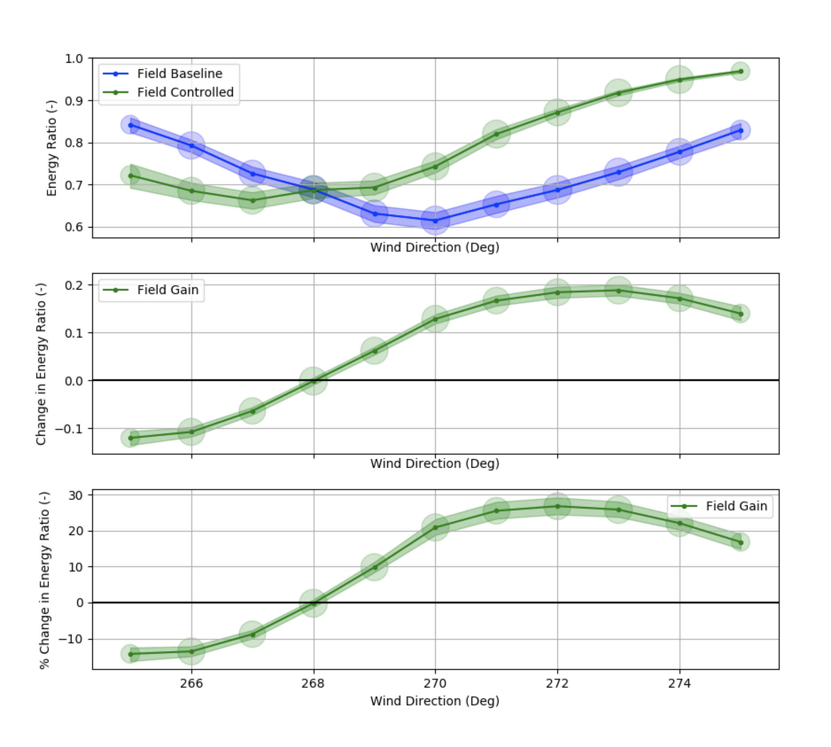
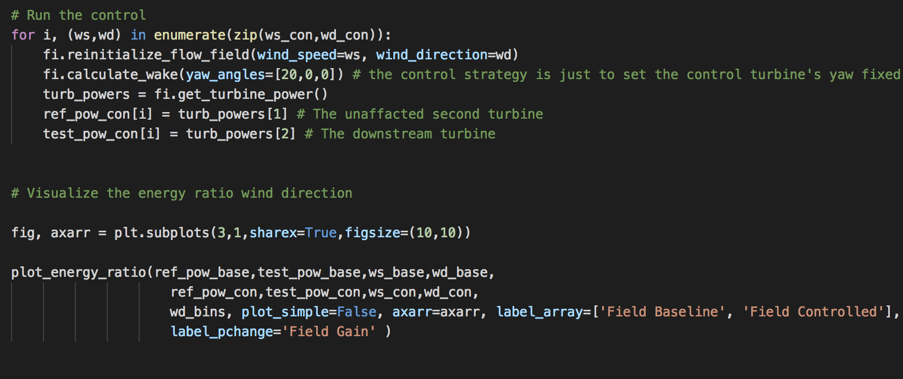
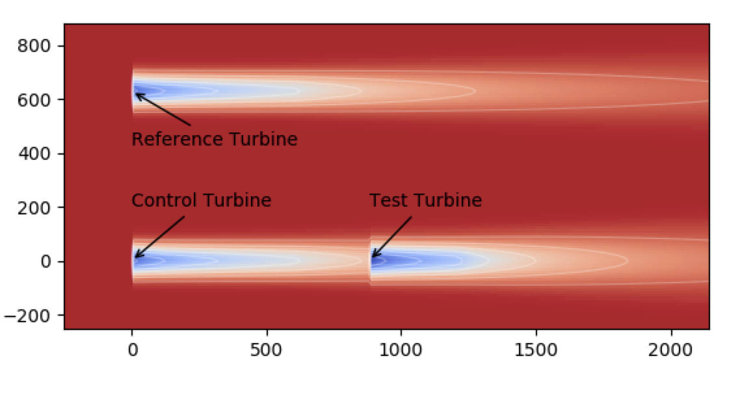
Energy Ratios
https://github.com/NREL/floris/blob/master/examples/example_0030_demo_energy_ratio.py

Slide 40
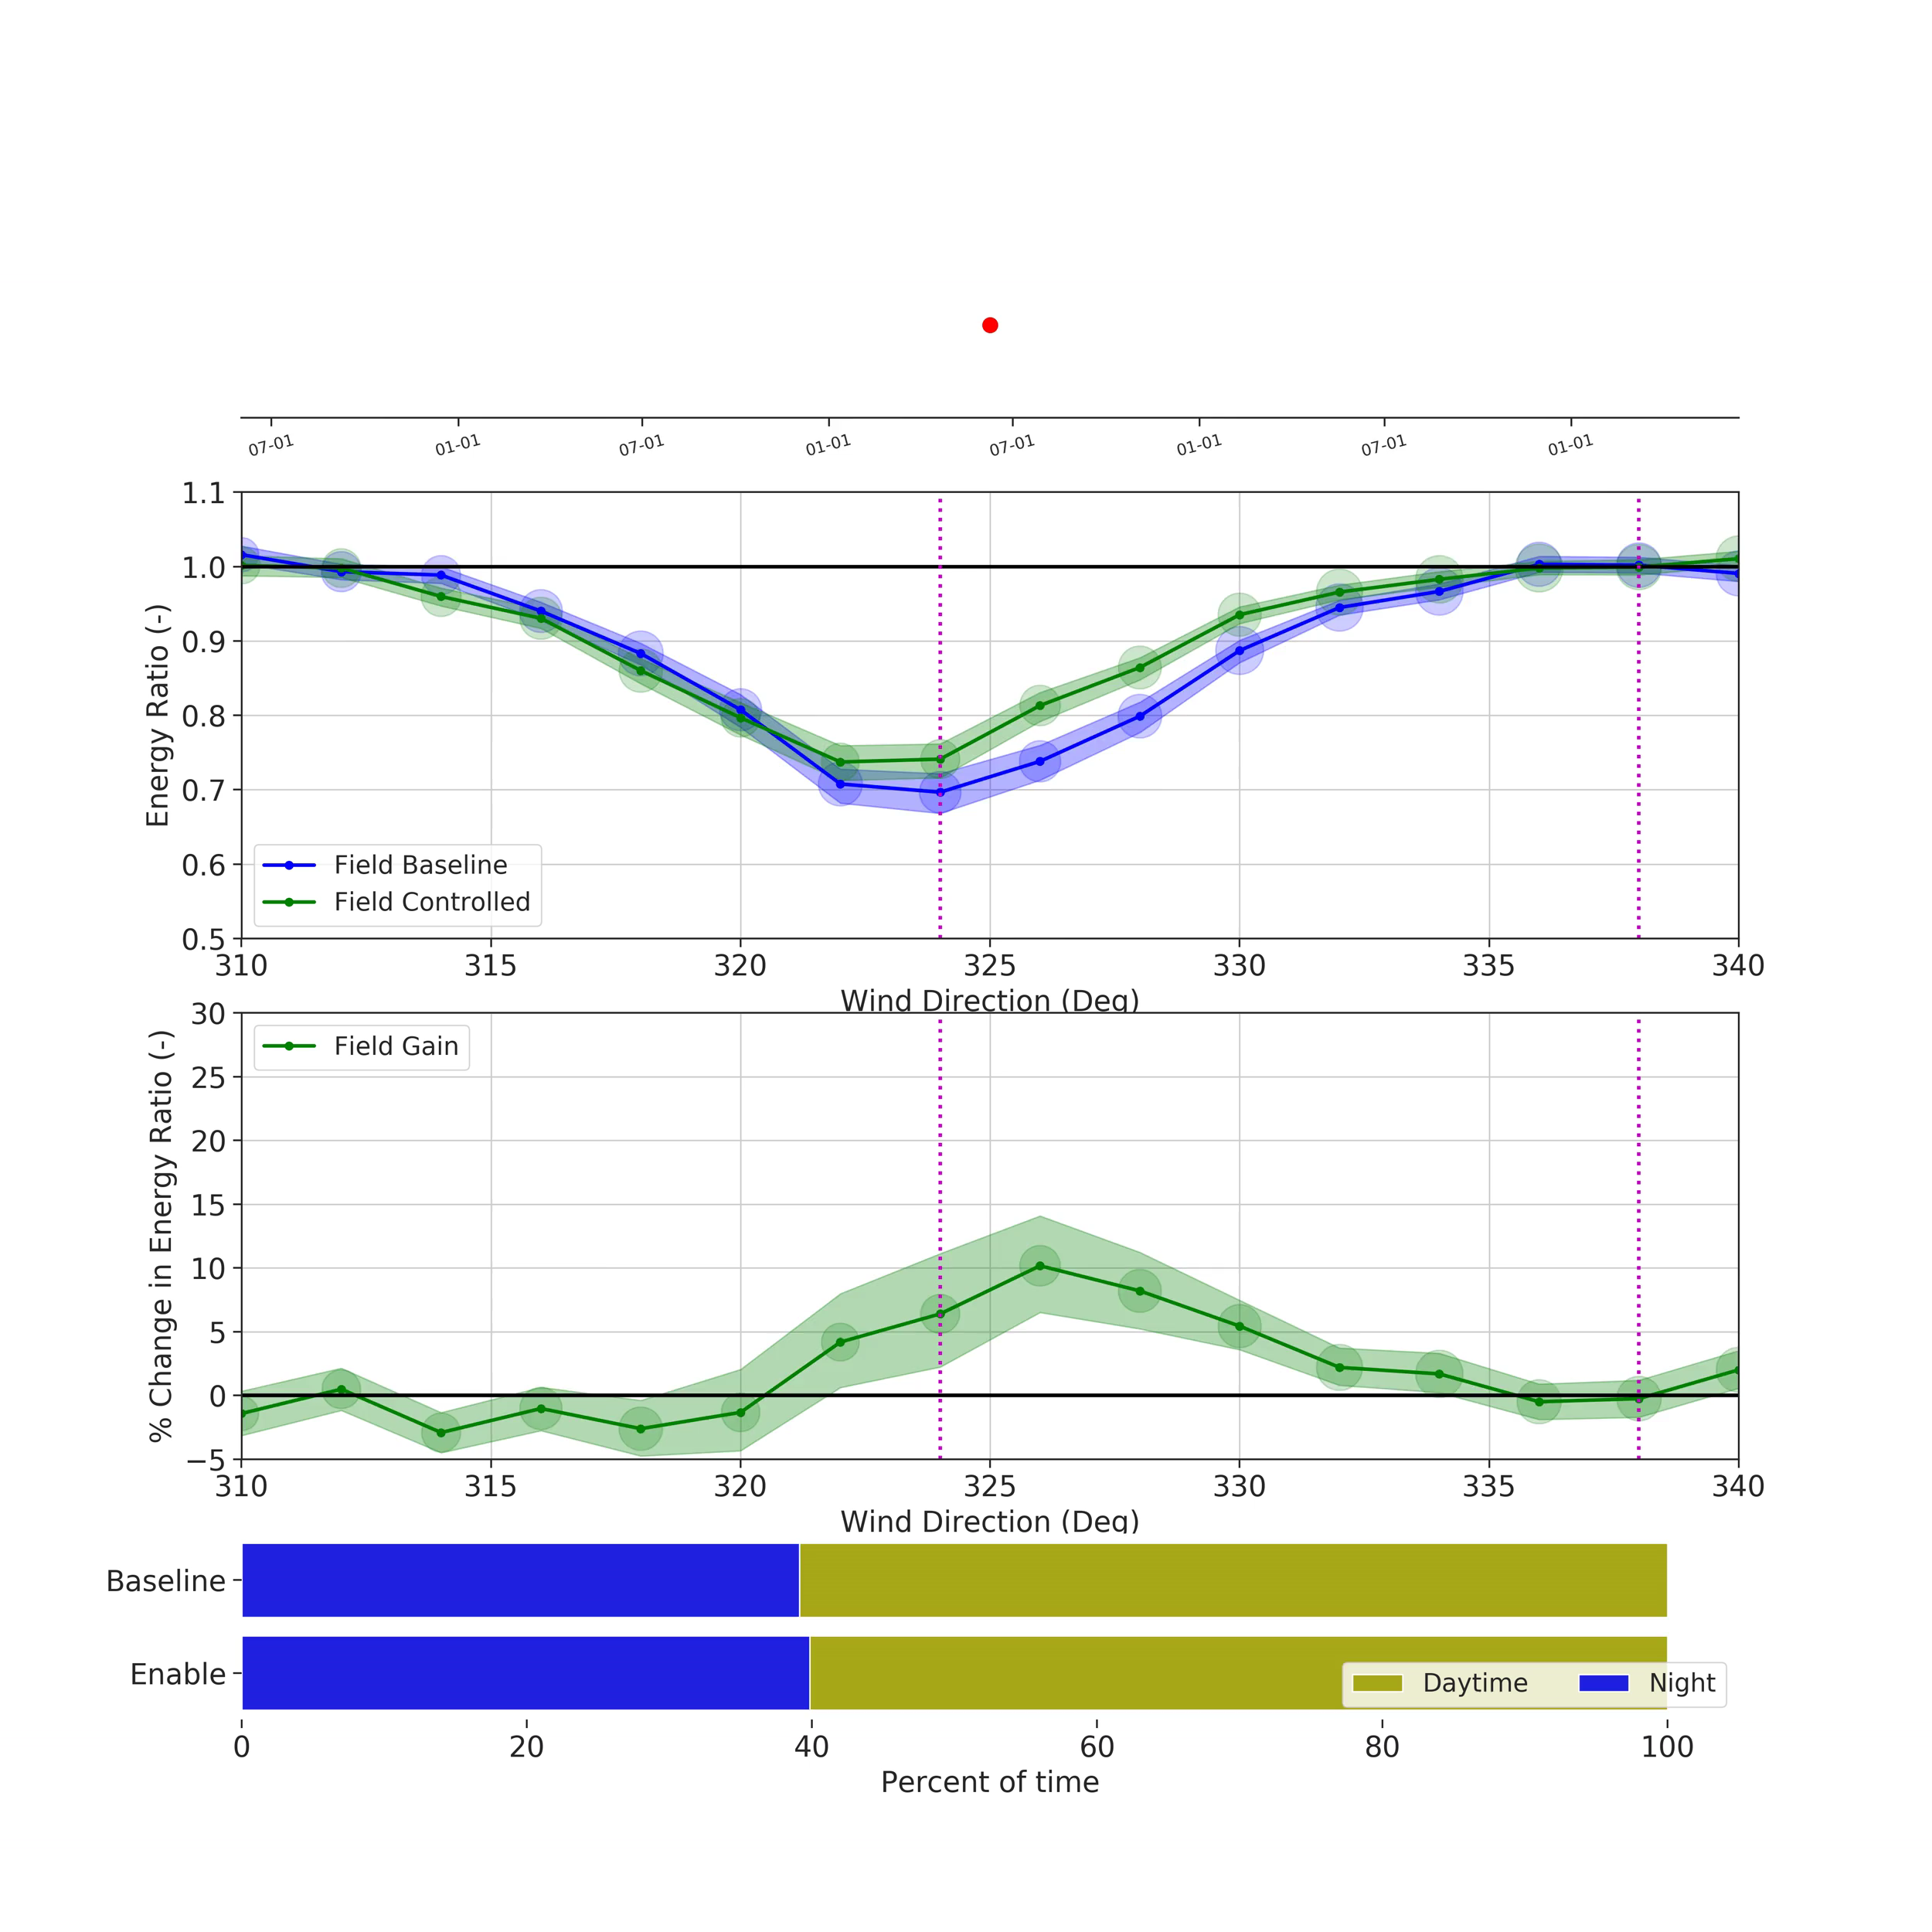
Energy Ratios – Over time
Notes:
This slide to be animated

Slide 41
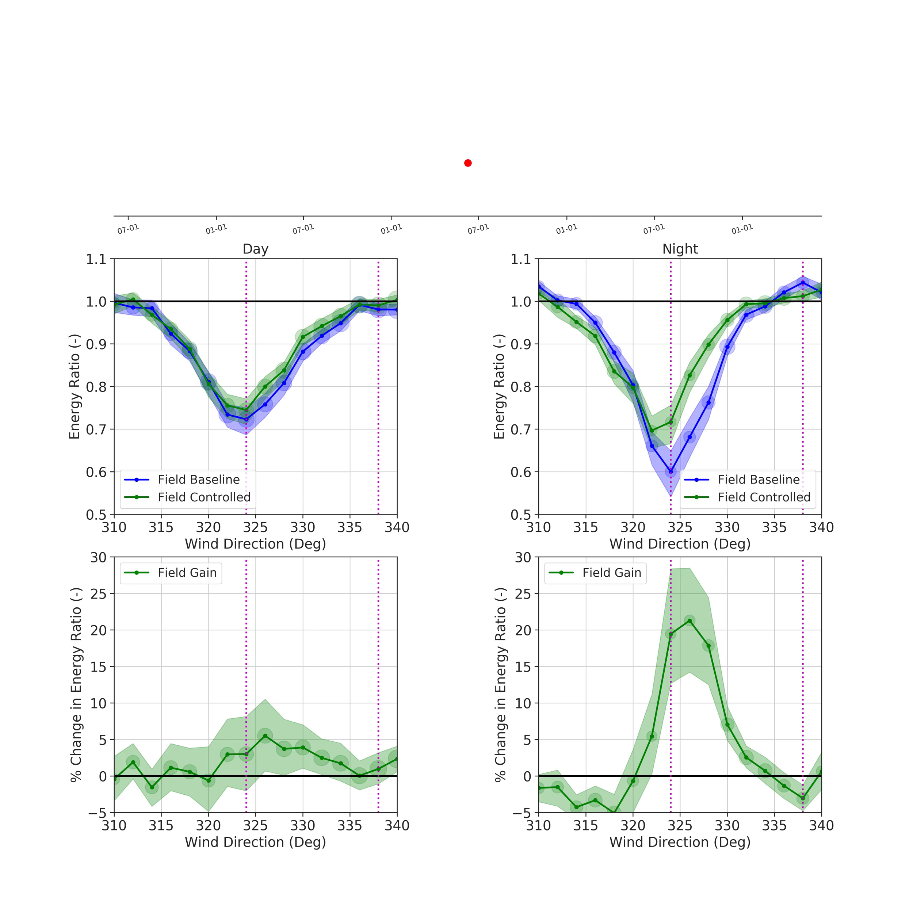
Energy Ratios – Day and Night
Notes:
This slide to be animated

Slide 42
Atmospheric Conditions

Slide 43
Validation Conditions
Most observations within a single bin, 46 1-hour time series with:
4.5 < ws < 6.0 [m/s]
290 < wd <300 [˚]
3.0 < TI <6.0 [%]

Slide 44
Validation Conditions
Most observations within a single bin, 46 1-hour time series with:
4.5 < ws < 6.0 [m/s]
290 < wd <300 [˚]
3.0 < TI <6.0 [%]
What about these?

Slide 45
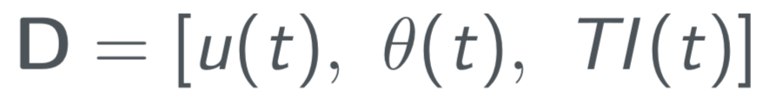
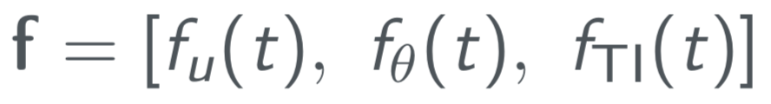
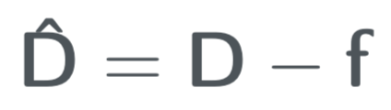
Validation Conditions
Data are normalized for meaningful comparison of variances an other statistical measures,
Regularizing a data block can tune the method to pick out any event type of interest,
The difference between objective functions and their respective data is considered to be a regularized data block,

Slide 46
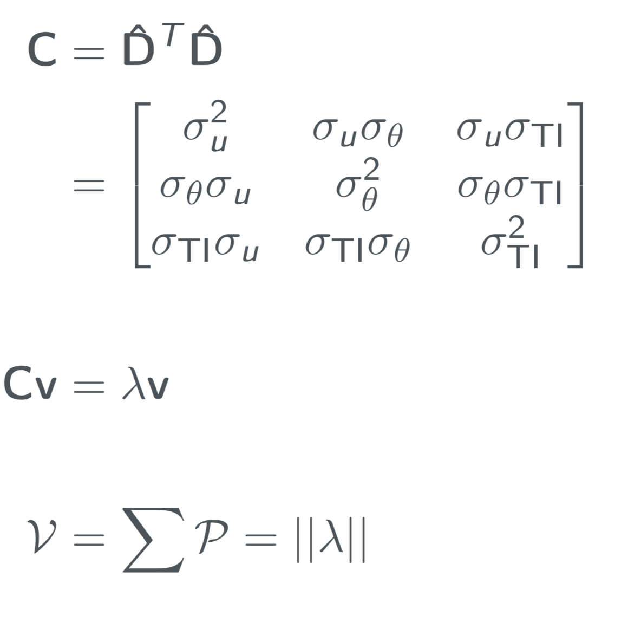
Validation Conditions
Covariance matrix quantifies the inherent variability of each data stream and the inter-channel dependence,

Slide 47
Validation Conditions
f = 0
Null object functions regularize the total variation metric to stationary conditions.

Slide 48
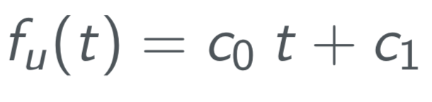
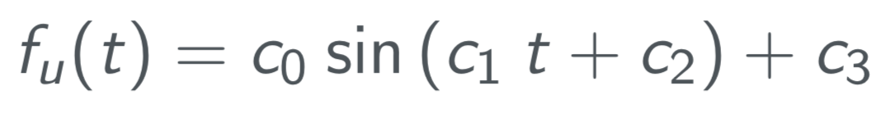
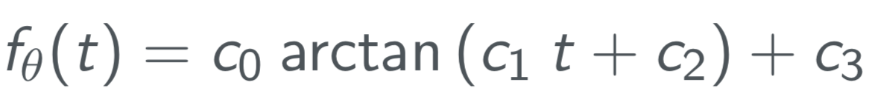
Validation Conditions
Wind speed ramp
Wind speed wave
Wind direction change

Slide 49
Validation Conditions

Slide 50
Validation Conditions

Slide 51
Field Validation

Slide 52
Field Validation
All Observations
Observed power production benefit from wake steering doubled by controlling for transient atmospheric conditions.
Low V Observations

Slide 53
Field Validation

